Slide 1
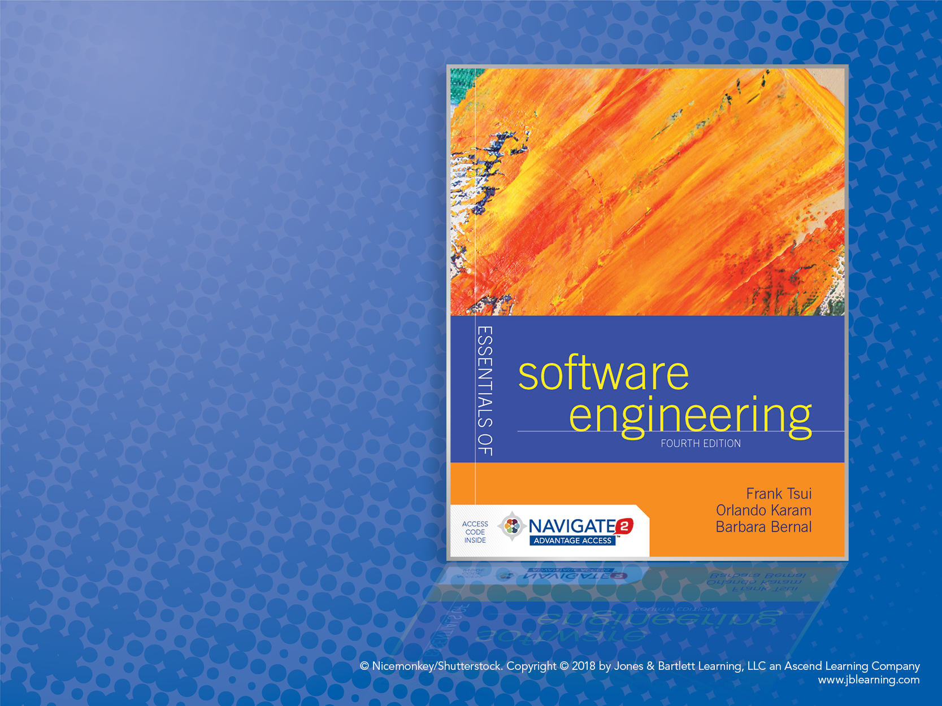
Chapter 2: Building a System

Slide 2
Building a “System”
Moving from writing a program to building a system. What’s the difference?!
Complexity, size, Complexity, size ------ Complexity
Breadth of Complexity
Depth of Complexity

Slide 3
Increase of Complexity Everywhere
Solution
Problem
transformation
Increase in
effort due to
size & complexity
Increase in
size & complexity
Increase in
size & complexity

Slide 4
Complexity (Breadth)
More functionalities
More features within each functionality
More varieties of interfaces (internal & external)
More users and varieties of users
More data, varieties of data, data structures
For your assignment 1, what happens if the number of input data increases to 1 trillion and the input numbers themselves are pretty large ?

Slide 5
Complexity (Depth)
More linkages and connections
Data sharing among the functionalities & logic
Control passing among functionalities

Slide 6
Examples for In-Class Discussion
Assignment 1 — compute and show the “average” of the read-in numbers.
“Modified” Assignment 1 — show the largest and the smallest of the read-in numbers.
Where is the complexity increase?
“Further Modified” Assignment 1 — show the read-in numbers in a sorted ascending order.
Where is the complexity increase?

Slide 7
Handling Complexities (A)
Via “simplification”
Decomposition of the problem and of the solution
Modularization of solution
Separation of concerns of problem and of solution
Incrementally resolve problems
*** Not “advertised” but a sometimes used technique is: REDUCE the problem.

Slide 8
Handling Complexities (B)
Via “improving technology and tools”
Database to handle information and structures of information
Programming and dev. platforms
Computing network
Multi-developer configuration management
Modeling techniques of problem and solution
Automated testing
Note: the first time you use these, it will actually be more complex.

Slide 9
Handling Complexities (C)
Via “improving process and methodologies”
Coordinate multiple and different people performing different tasks
Guidance for overlapping incremental tasks
Guidance for measuring separate artifacts and outcomes
Note: first time you put in a process—it is like the new tool—it is more complex.

Slide 10
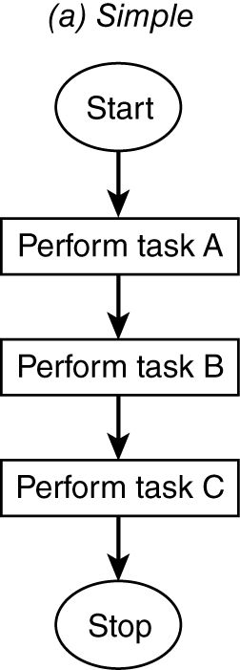
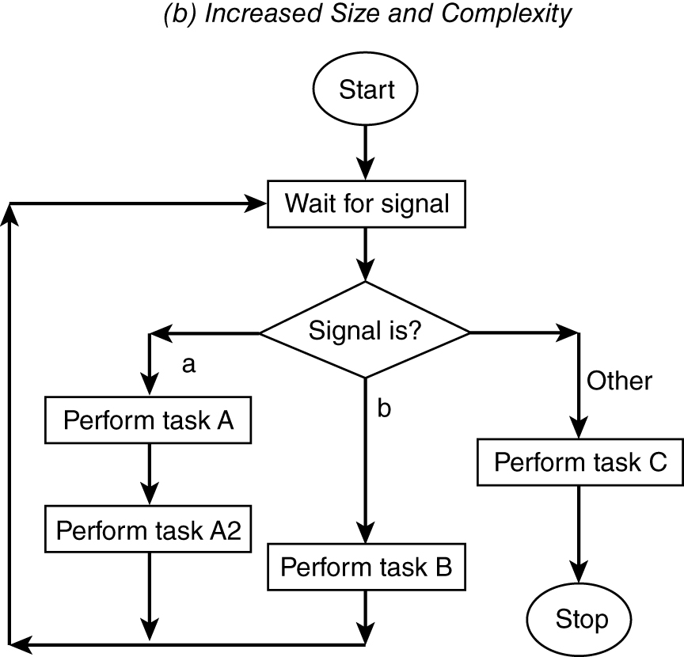
Example of Size and Complexity Increases
(a) Simple
(b) Increased Size and Complexity

Slide 11
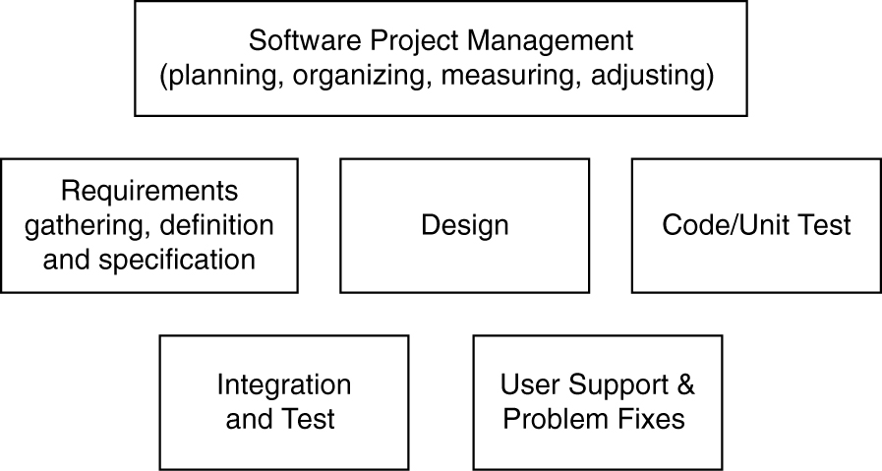
Task Breakdown (Macro) Example (Handling Complexity)
1. Who performs what task?
2. How is the task completed with what technique or tool?
3. When should which task start and end?
4. Who should coordinate the people and the tasks?

Slide 12
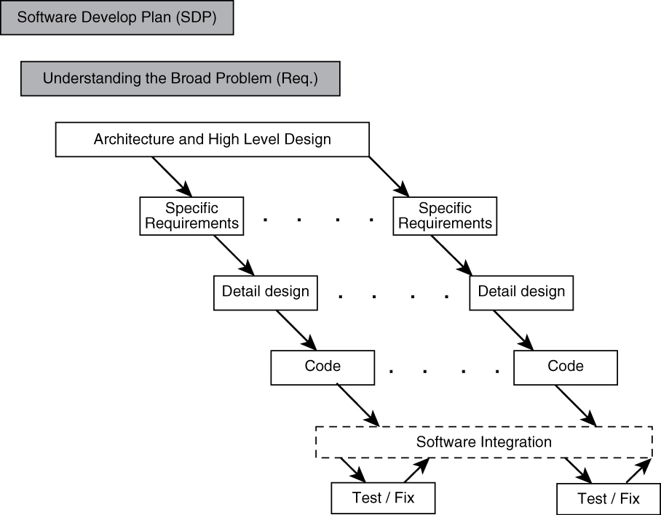
Iterative Process Example (Handling Complexity)

Slide 13
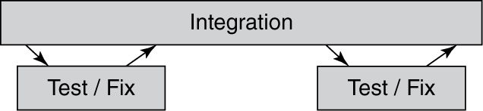
Handling the “Details” Separately
Seemingly “simple” test/fix and integrate steps:
Should there be separate and independent test group?
How should problem be reported and to whom?
How much information must accompany a problem report?
Who decides on the priority of the problem?
How is the problem fix returned?
Should all problems be fixed?
What should we do with non-fixed problem?
How are fixes integrated back to the system?

Slide 14
Some “Non-Technical” Considerations for Developing & Supporting a System (requiring more effort, more resources, etc.)
Effort and Schedule Expansion
How does one estimate and handle this?
Assignment and Communications Expansion?
Do we need some process?
Do we need some tools?

Slide 15
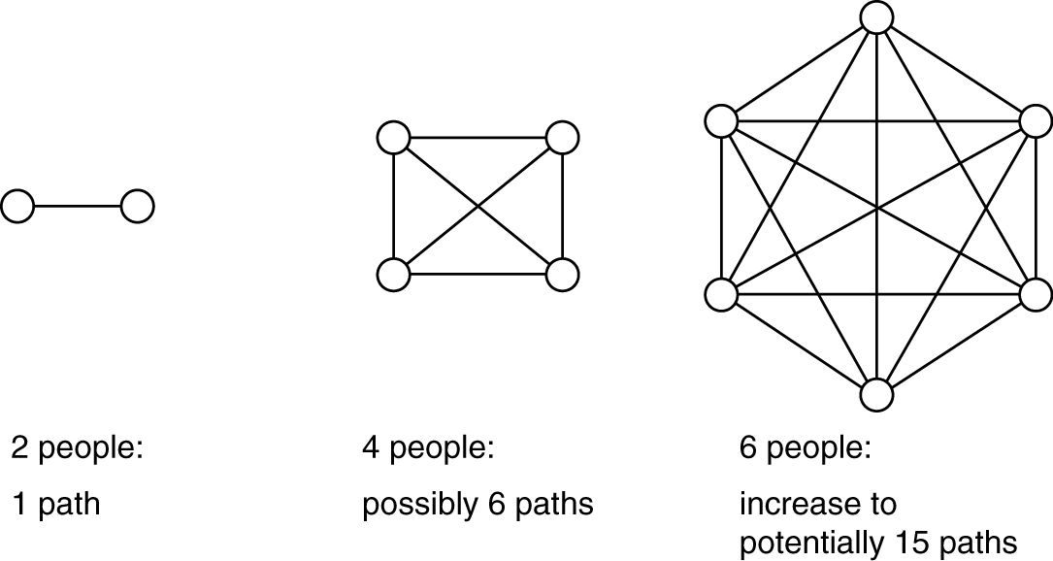
Increase in amount of communications as # of people increases. Also, an increase in the number of communications errors committed.
With the increase in system complexity, there is a corresponding increase in the “manpower” or human resources.
For n people, number of potential communications paths = ∑ (n−1) = [nx(n−1)] / 2

Slide 16
A Large, Complex System
Building “mission-critical” or “business- critical” system (e.g., payroll − in textbook) requires (1) several separate activities performed by (2) more than one person (e.g., 50 ~ 100):
Requirements: gathering, analysis, specification, and agreement
Design: abstraction, decomposition, cohesion, interaction, and coupling analysis
Implementation: coding and unit testing
Integration and tracking of pieces and parts
Separate testing: functional testing, component testing, system testing, and performance testing
Packaging and releasing the system

Slide 17
Also, Need to “Support” the “Payroll” System in Text (for real production) (oftentimes complex systems are not “perfect”)
Pre-release: preparation for education and support:
Number of expected users
Number of “known problems” and expected quality
Amount of user and support personnel training
Number of fix and maintenance cycle
Post-release: preparation for user and customer support:
Call center and problem resolutions
Major problem fixes and code changes
Functional modifications and enhancements

Slide 18
Coordination Efforts Required in Systems Development and Support
Because there are (i) more parts, (ii) more developers, and (iii) more users to consider in “large systems” than a single program developed by a single person for a limited number of users, there is the need for coordination of (3P’s):
“Processes” and methodologies to be used
Final “product” and intermediate artifacts
“People” (developers, support personnel, and users)
The previous diagram on people increase and potential communication paths
increase provides a clue to the importance of coordination efforts.

Slide 19
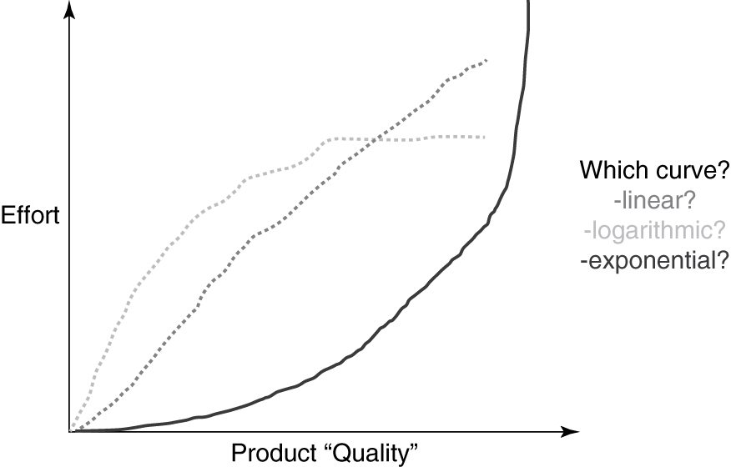
Effort vs. Software Product “Quality”

Slide 20
Complexity vs. Software Product Quality? Complexity vs. Software Dev. Effort? What type of “relationship” can we expect?
Complexity
Complexity
?
?
Software Product Quality
Software Development Effort

